Slide 1

Agile Project Management Software
01

Slide 2
Agile Project Management Software
Presented By :
1. Md. Samim Sarkar (193015060)
2. Sakhawat Hossain (193015069)
3. Kazi Abrar Ahmed (193015056)
Supervised By :
Mr. Palash Roy
Lecturer , Dept of CSE.
Green University of Bangladesh
02
25-03-2022

Slide 3
Table of Contents
01
02
03
05
Introduction
Objectives
Motivation
Related works
Project Feature & Requirements
Tools and Technique
Use Case, DFD, Gantt Chart
ER Diagram
Project Overview
Conclusion
Test Case
Future Work
References
04
03
25-03-2022

Slide 4
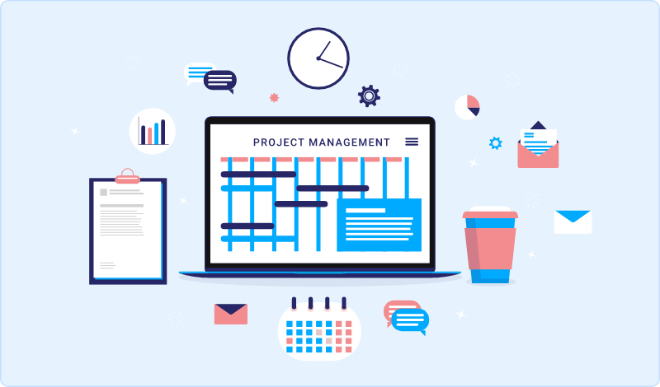
Introduction
Intrack is a cloud-based project management software
It allows businesses to manage, collaborate, communicate, and organize their tasks and projects
25-03-2022
04

Slide 5

Objective
Provide a user-friendly and efficient platform for project management.
Improve collaboration and communication between team members.
Ensure better organization of tasks and deadlines.
Provide analytics to track progress and identify areas for improvement.
05
25-03-2022

Slide 6
Motivation
01
Use agile innovation methods outside of tech.
02
Explore the possibilities of agile in other industries.
Streamline and automate repetitive tasks to increase efficiency and save time.
04
Provide a centralized hub for communication and project management.
03
06
25-03-2022

Slide 7
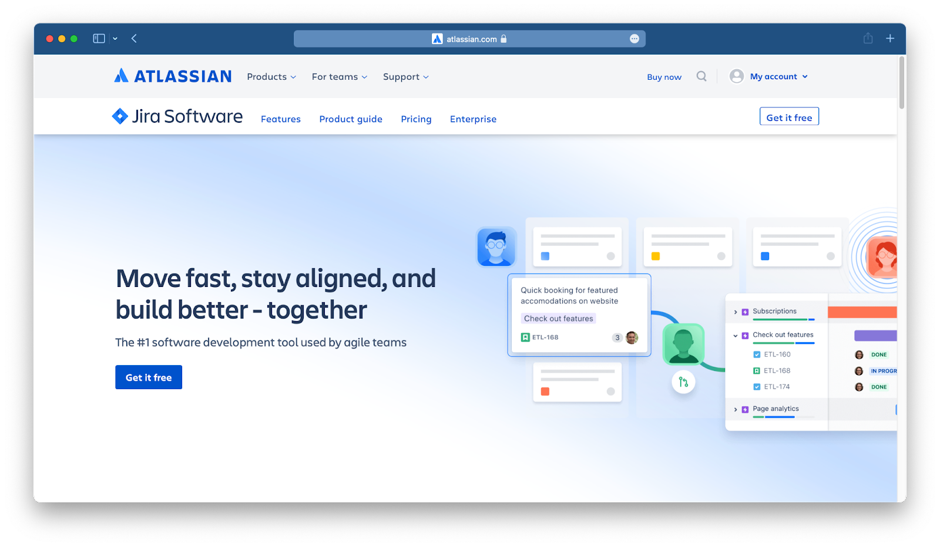
Related works
Jira is a software application used for issue tracking and project management.
Limitations:
It's complicated user interface can make managing tasks difficult.
It's mainly built for engineering and software development teams.
www.atlassian.com/software/jira
07
25-03-2022

Slide 8
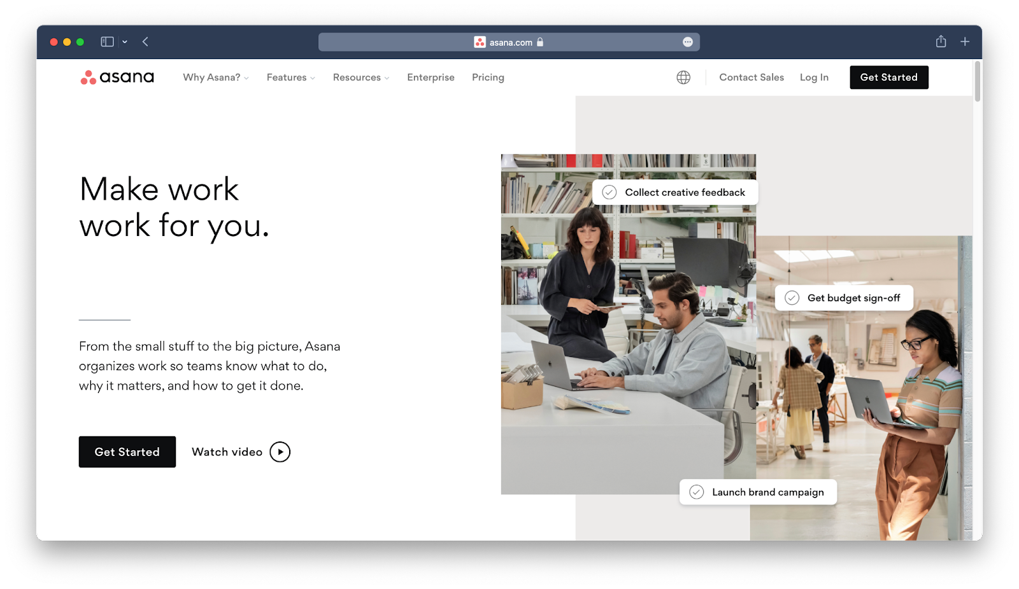
Related works
Asana is a web-based task management and collaboration software.
Limitations:
Limited features on the free version
Not meant for heavy project management
Not Very Friendly to New Users
www.asana.com
08
25-03-2022

Slide 9
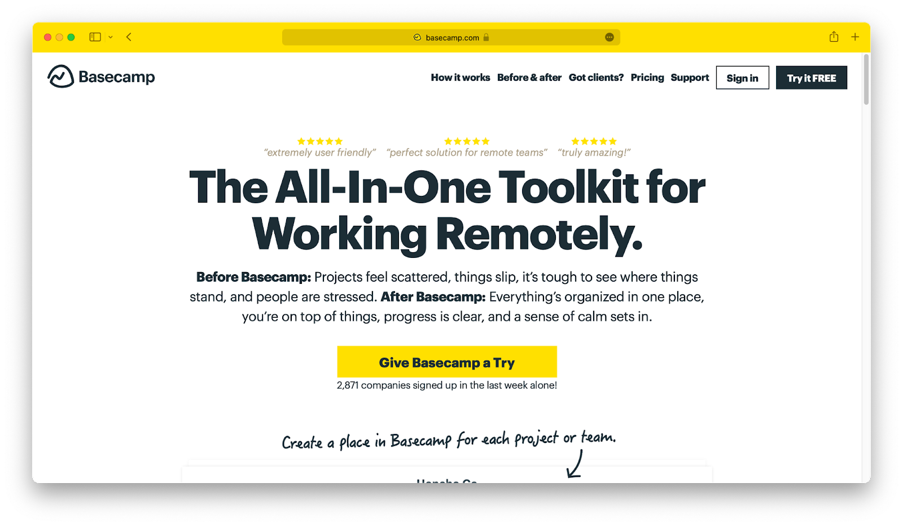
Related works
Basecamp is a collaborative project management software and daily task tracking application.
Limitations:
Extremely limited functionality.
The interface can be confusing to deal with.
Can’t customize task statuses.
Limited project tracking feature.
www.basecamp.com
09
25-03-2022

Slide 10
Project Feature
01
Tasks
Projects
04
02
05
Sprint
Kanban Board
03
Collaborators
06
RoadMap
10
25-03-2022

Slide 11
Requirements
Functional Requirements:
The manager should be able to create a project and invite team members to the project.
The manager can assign tasks to anyone in the team.
Members will view their assigned tasks and update task status.
Both manager and team members should be able to prioritize the task
A verification email is sent to user whenever the user registers for the first time on the system.
Users can visualize their tasks on a List or Board view.
25-03-2022
11

Slide 12
Requirements
Non-Functional Requirements:
Project members are not allowed to delete the project.
The software should be platform-independent. So moving from one OS to another OS will not create any problems.
The processing of each request should be done within 10 seconds
The system must perform without failure in 95 percent of use cases during a month.
25-03-2022
12

Slide 13
Software Requirements and Language Requirements
Software Requirements:
VS Code
Git
Github
Figma
Any Web browser
Language Requirements:
In addition, the following technologies
we’ll use while developing the platform:
Back End:
Node.js/Express
MongoDB
Redis
Docker
Front End:
Angular/React.js
GraphQL
Day 3
25-03-2022
13

Slide 14
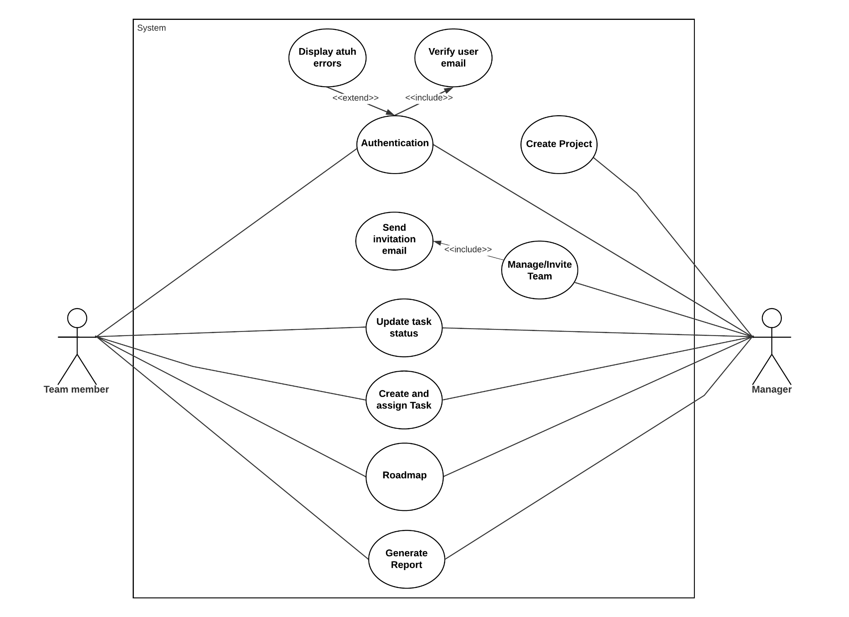
Use Case Diagram
14
25-03-2022

Slide 15
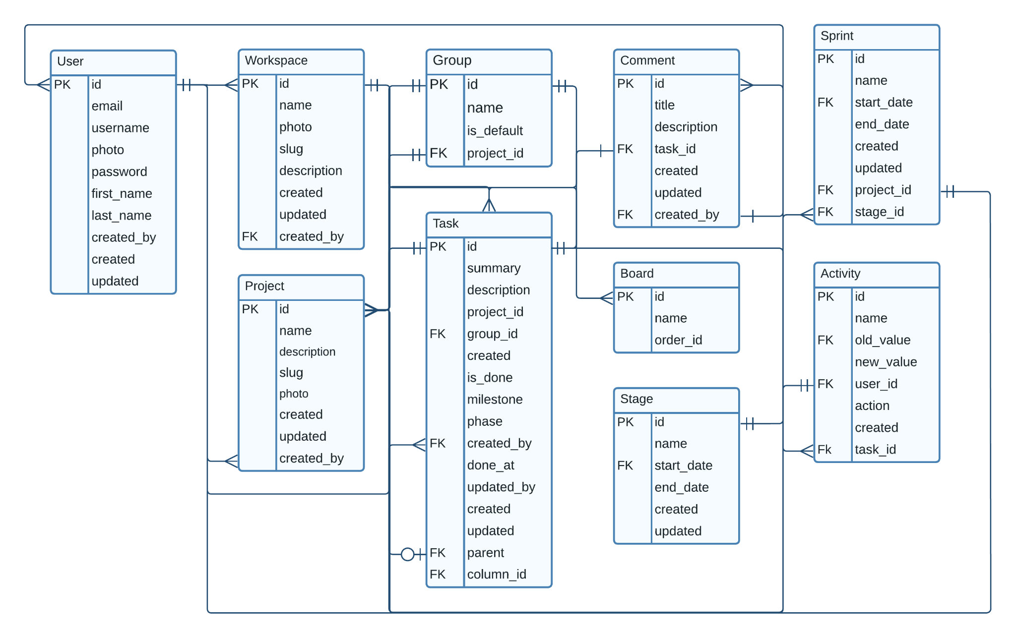
ER Diagram
15
25-03-2022

Slide 16
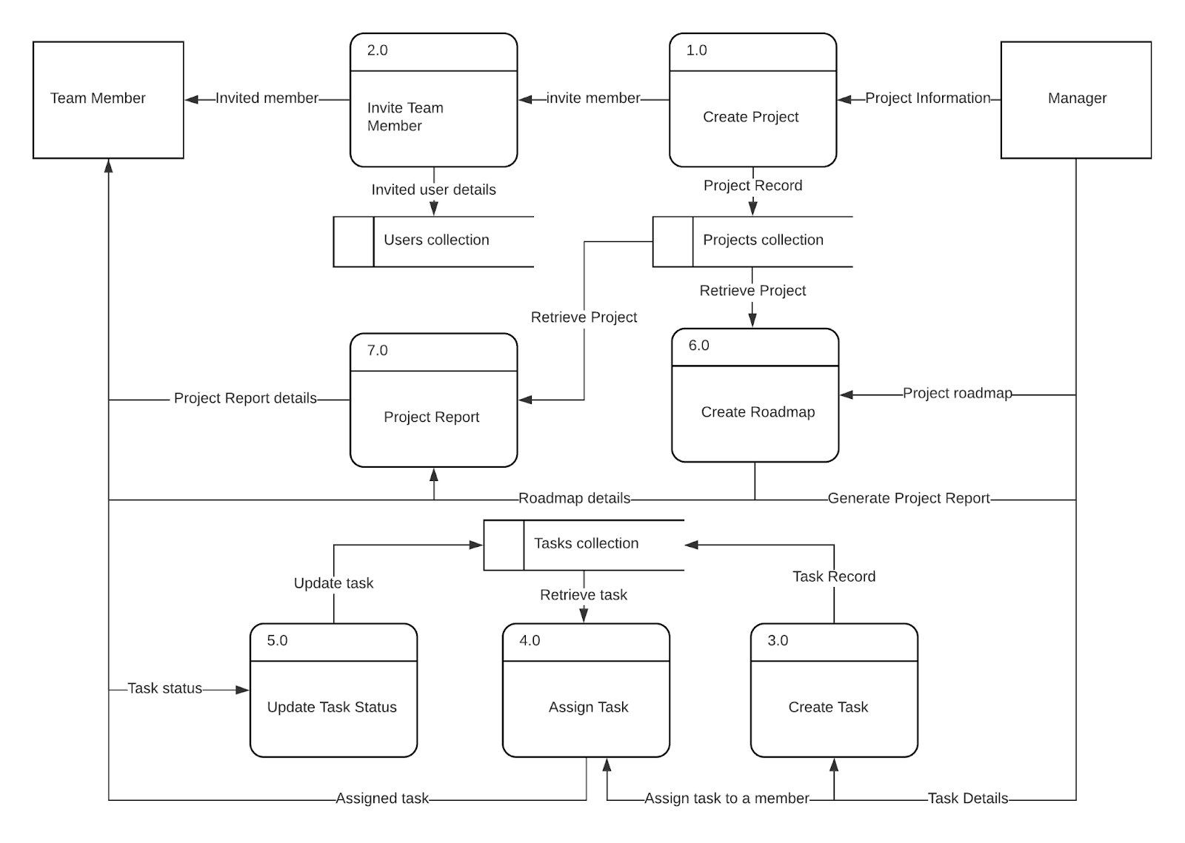
Data Flow Diagram
16
25-03-2022

Slide 17
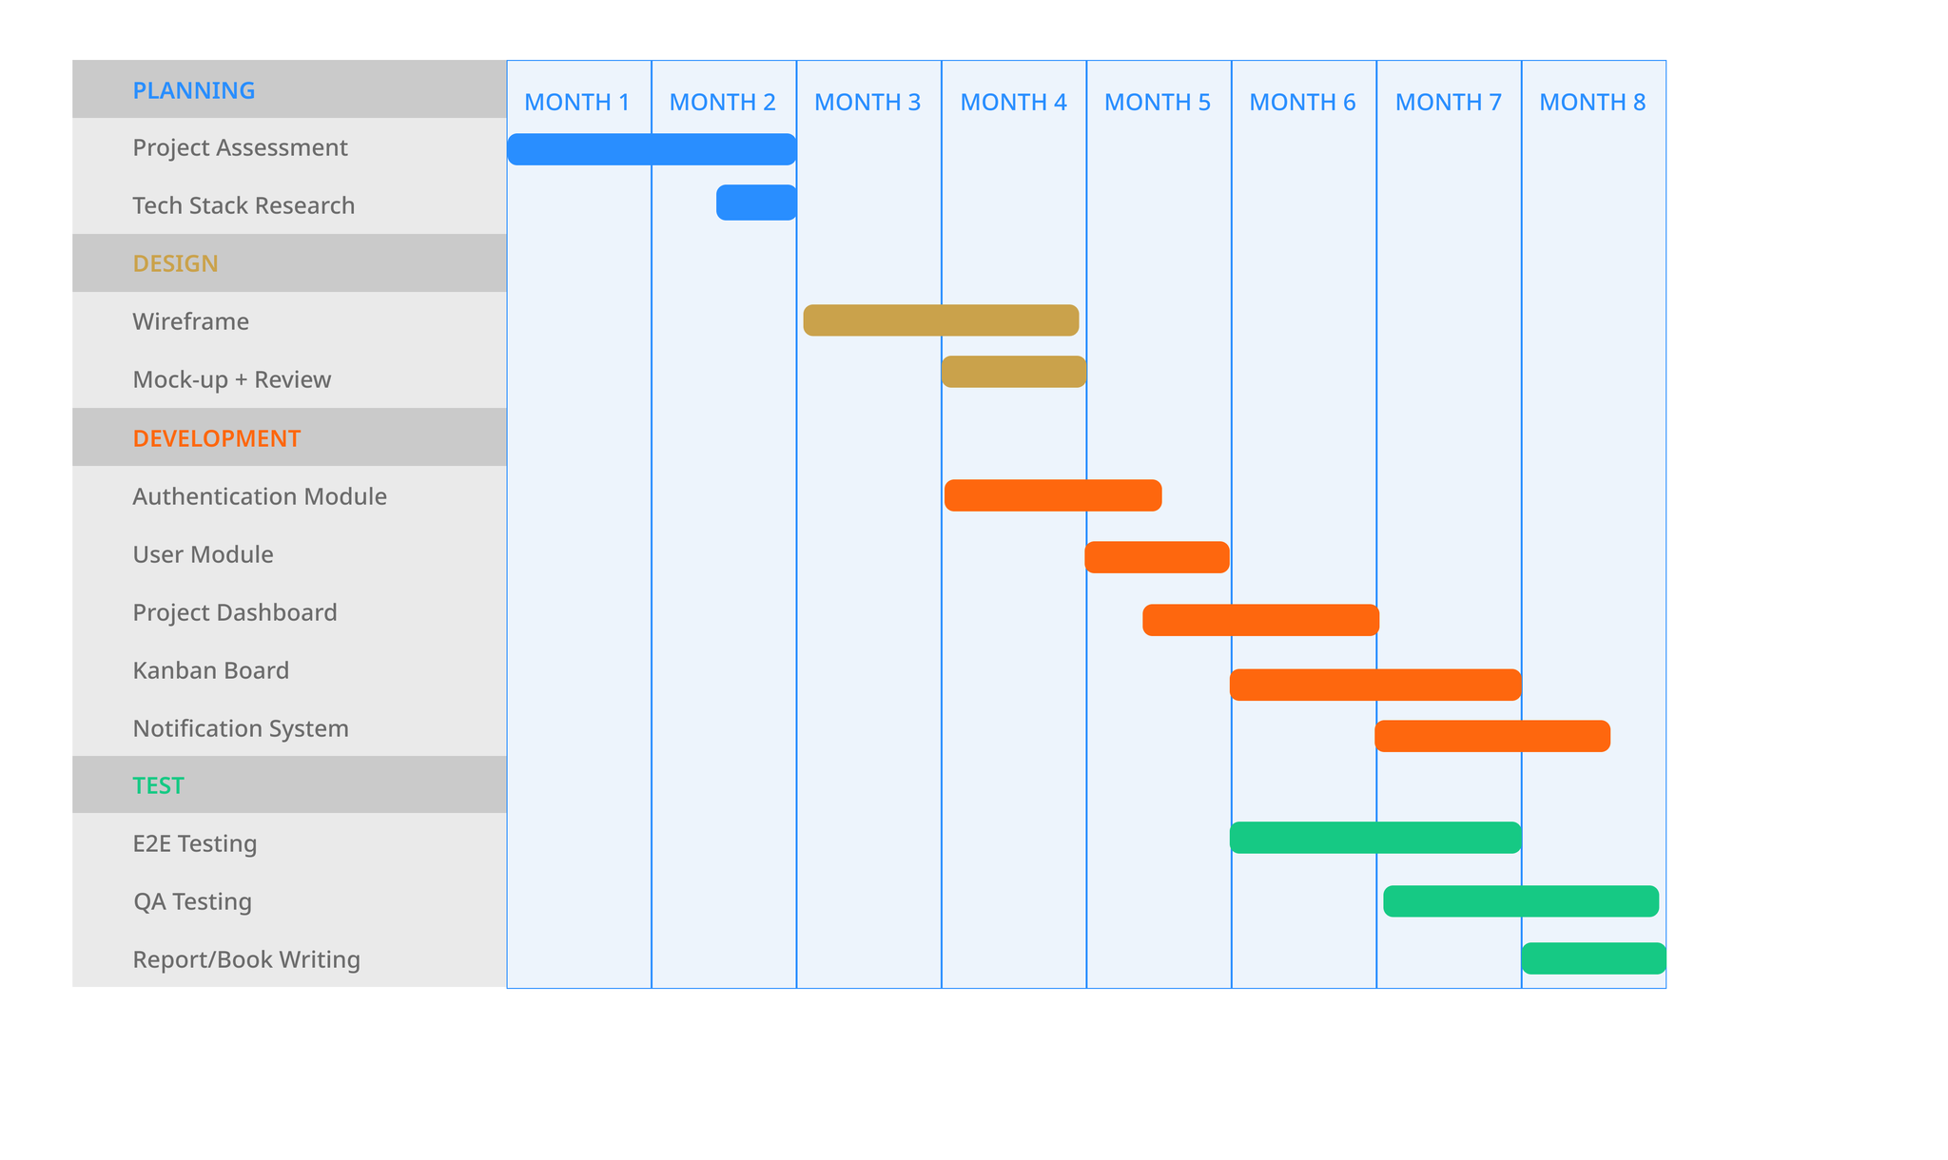
Gantt Chart
17
25-03-2022

Slide 18
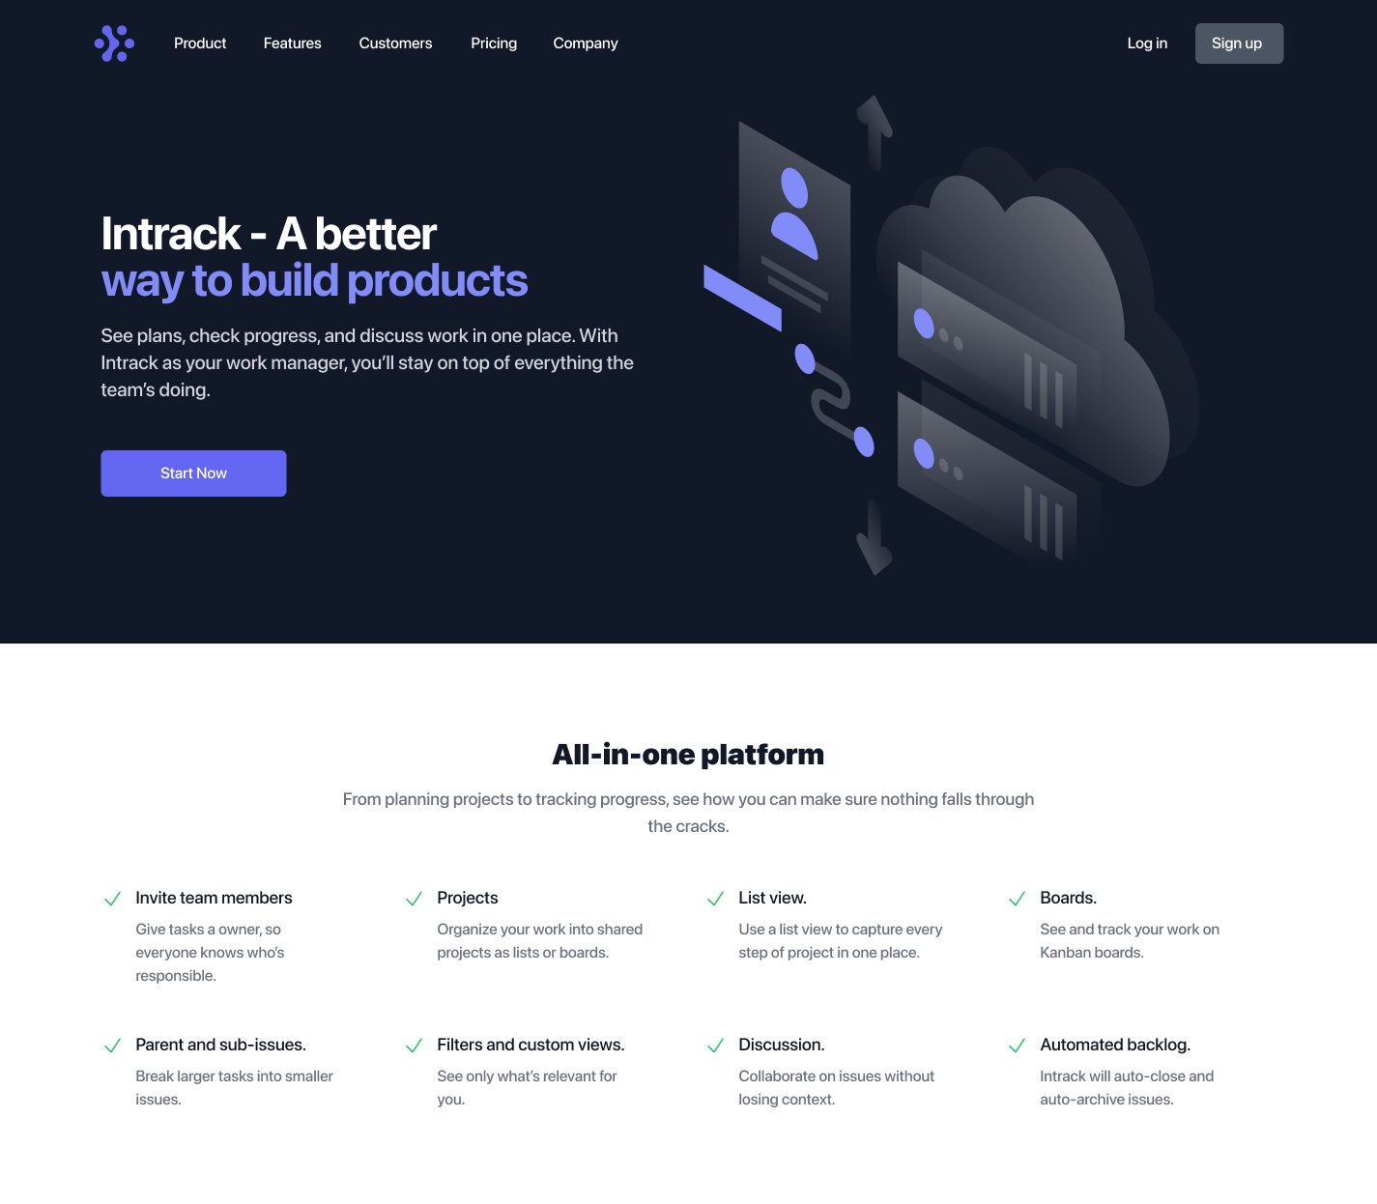
Project Overview
Hero Section
18
25-03-2022

Slide 19
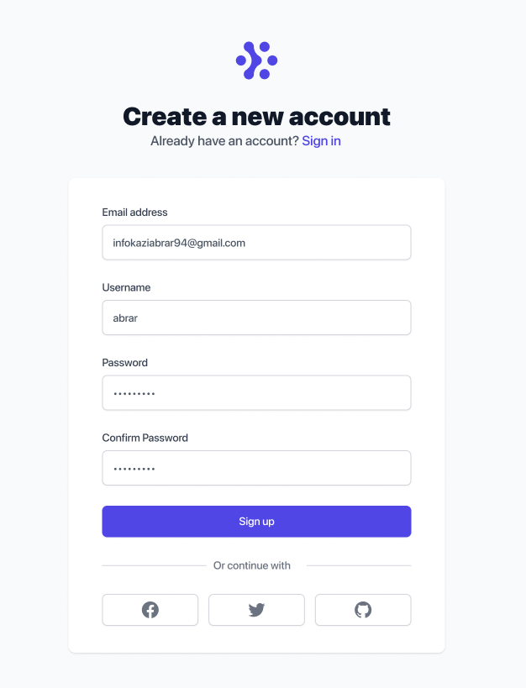
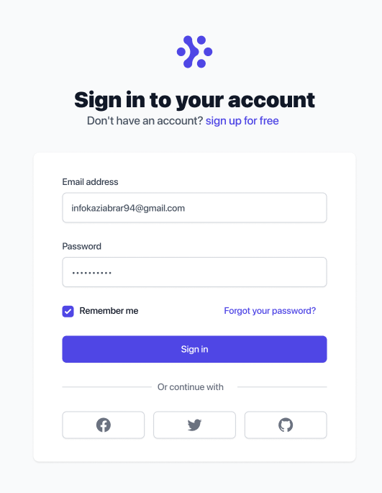
User Registration/ Login
19
User SignUp User Login
25-03-2022

Slide 20
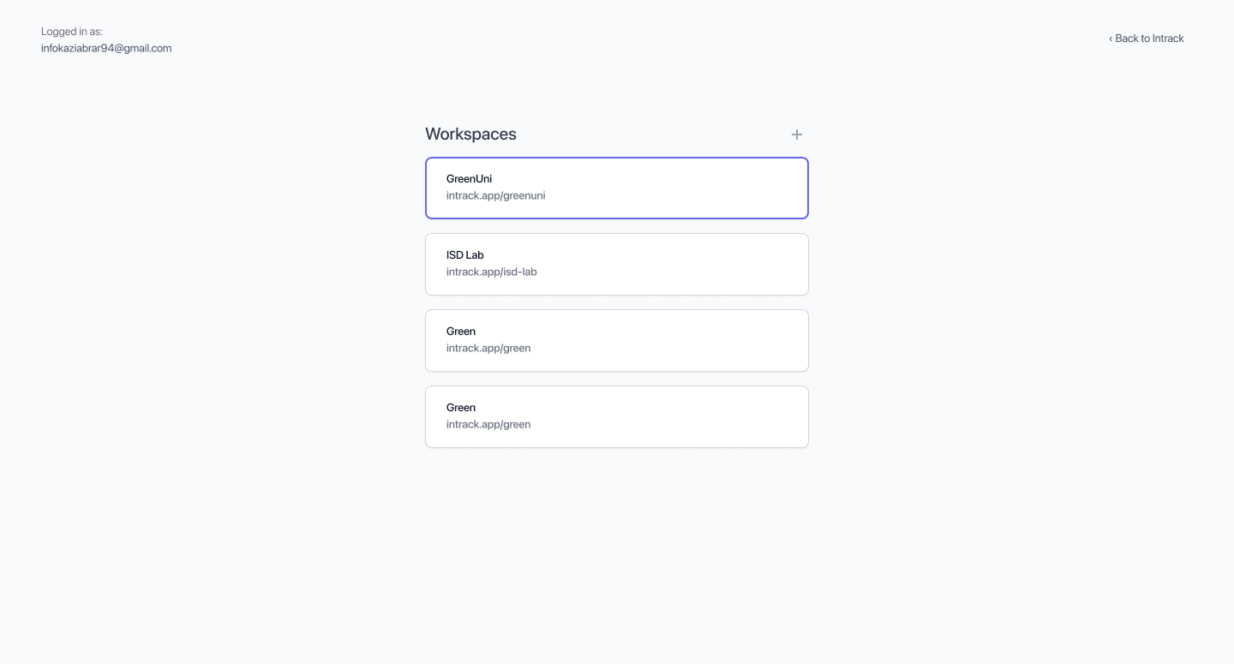
Workspace Creation
20
25-03-2022

Slide 21
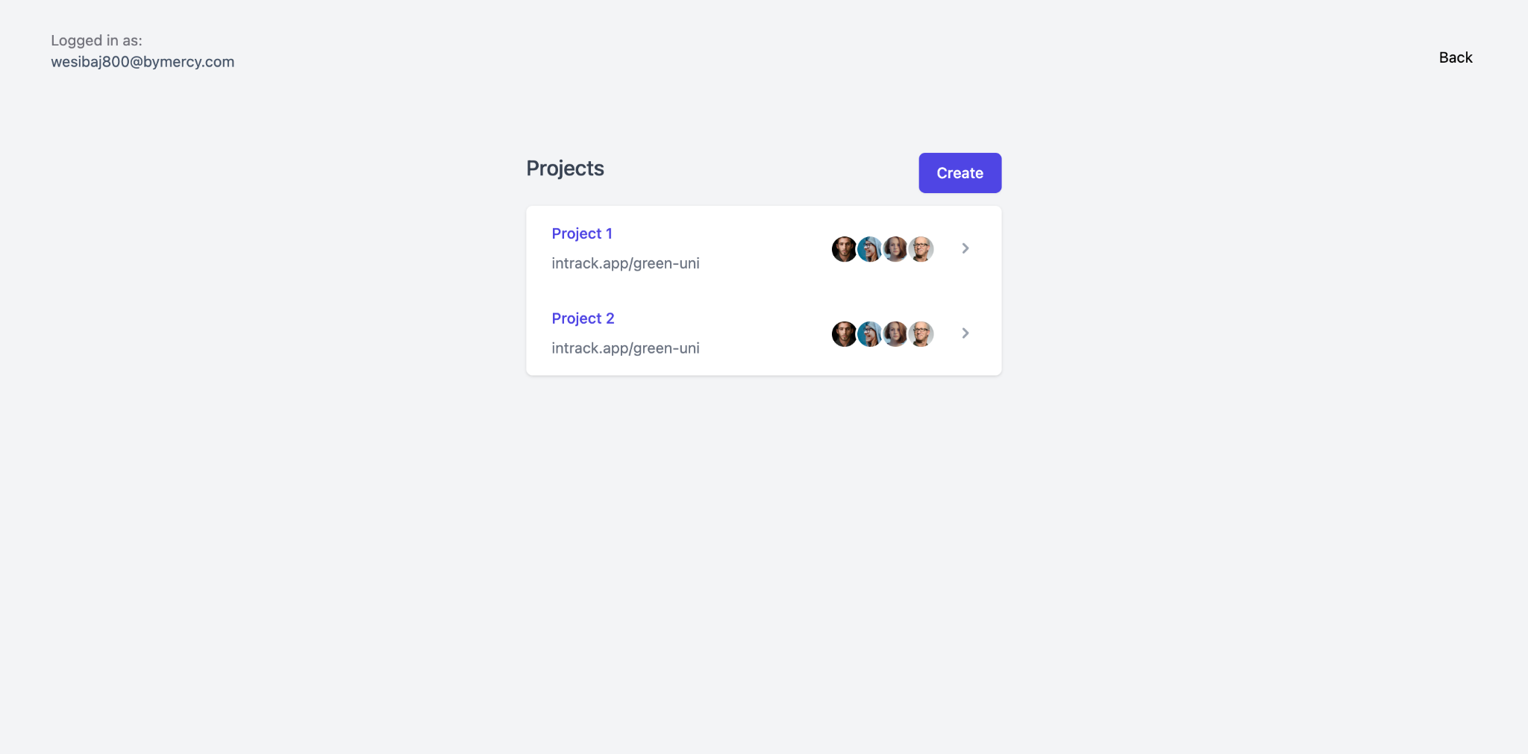
Project Creation
21
Project Creation
25-03-2022

Slide 22
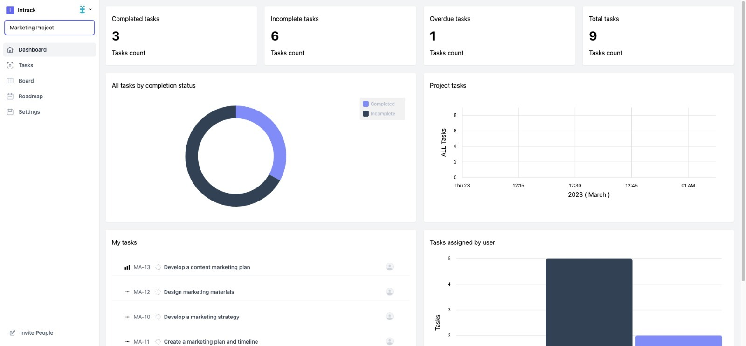
Dashboard View
22
Dashboard View
25-03-2022

Slide 23
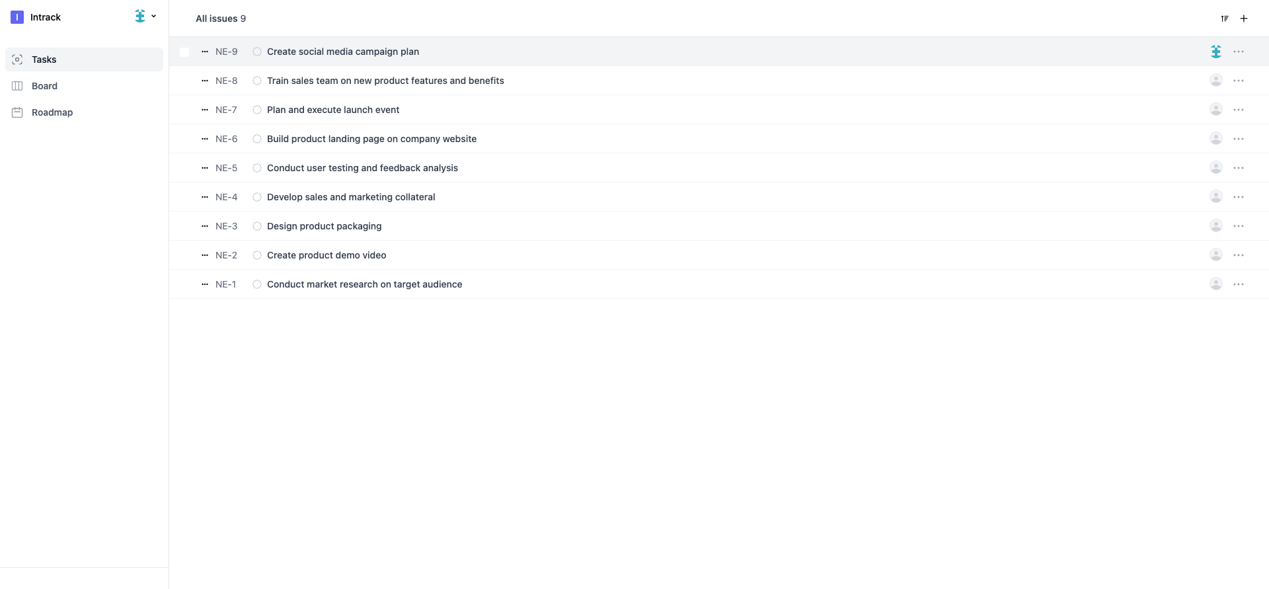
Task List
24
Task List
25-03-2022

Slide 24
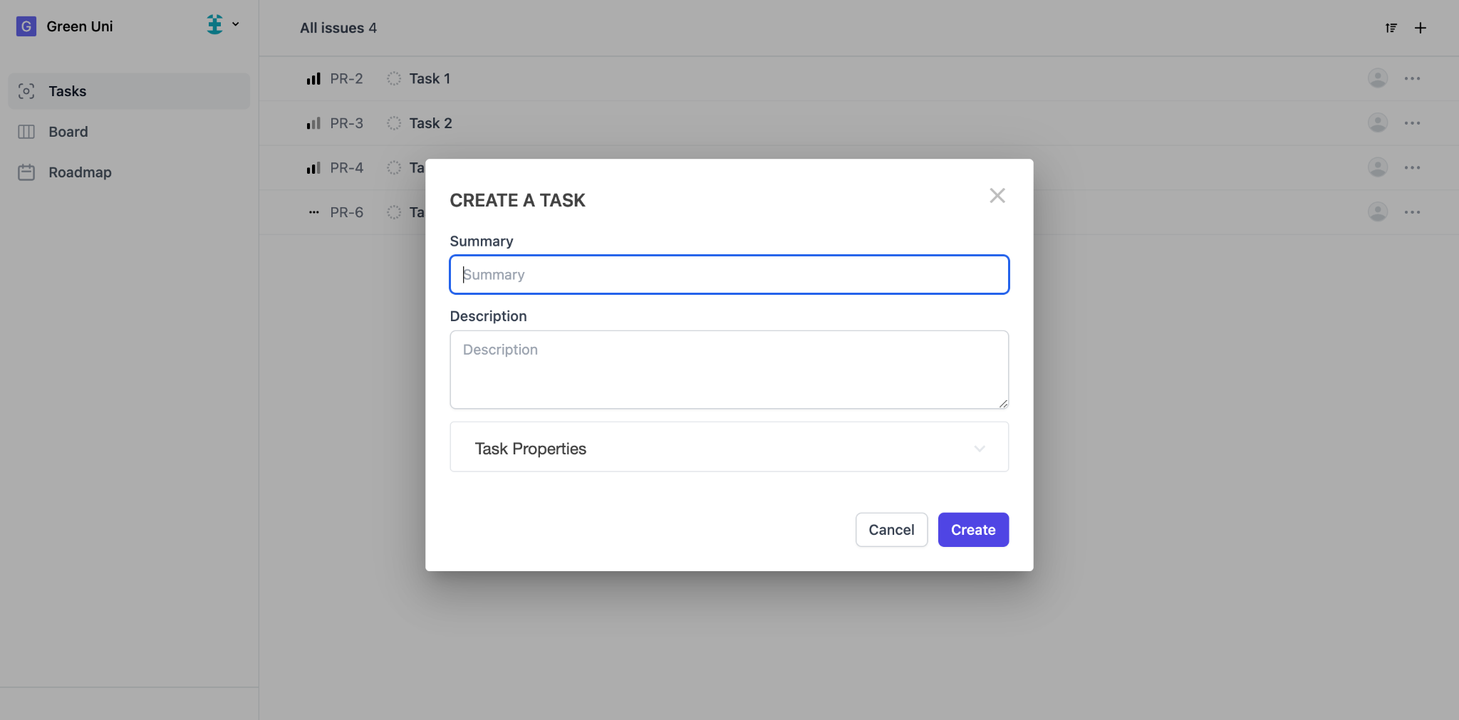
Task Creation
23
Task Creation
25-03-2022

Slide 25
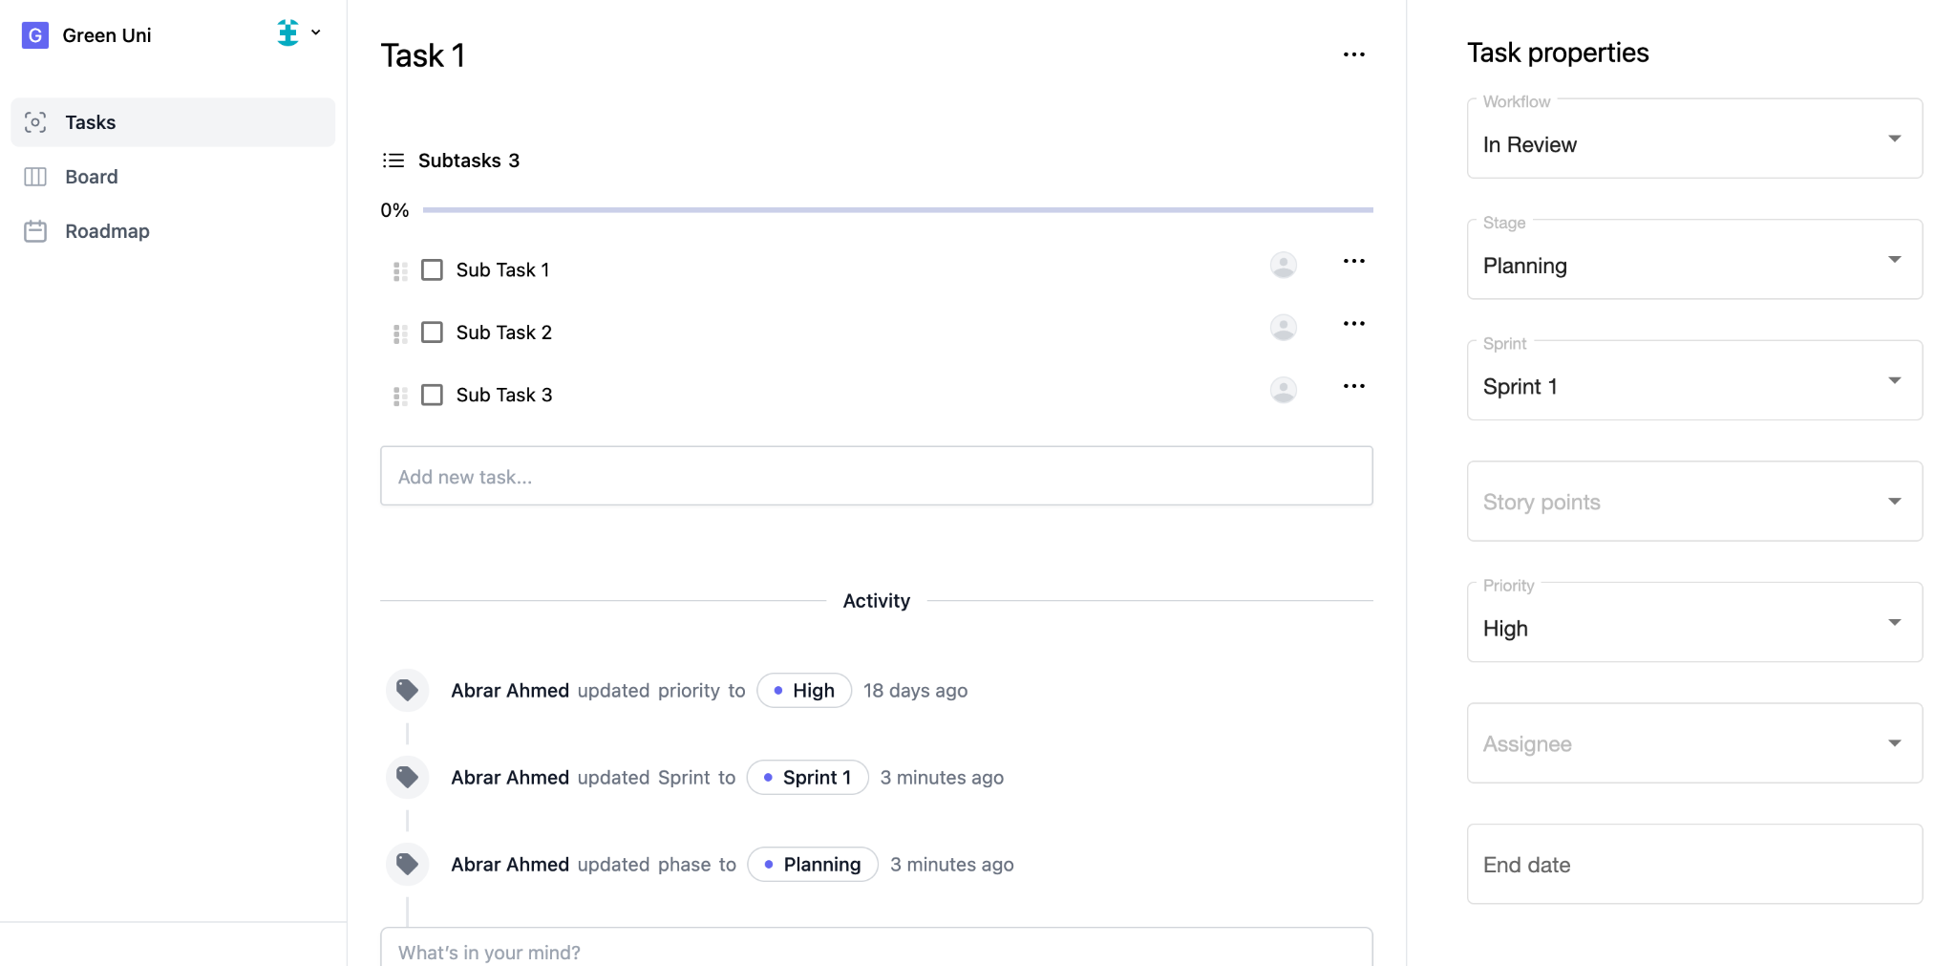
Task Details
25
Task Details
25-03-2022

Slide 26
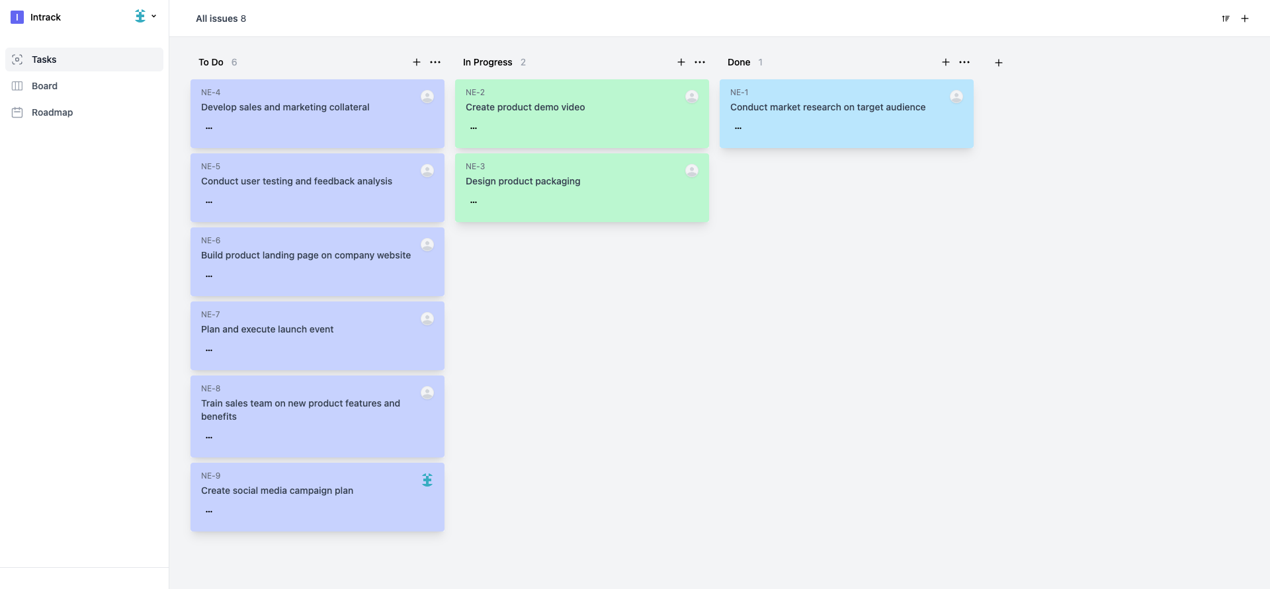
Kanban Board
To-Do
In-Progress
Done
26
25-03-2022

Slide 27
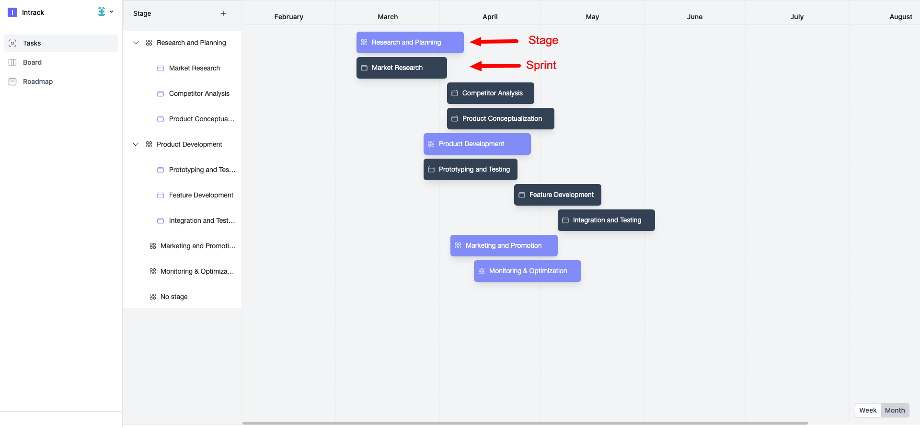
Project RoadMap View
27
Project Roadmap View
25-03-2022

Slide 28
Test Case
Account Registration
Account Login
Create a new Workspace
Create a new Project
Previous dates are Disabled
Create Stages
Invalid Column Name
Invalid Sprint Name
Sprint dates are Disabled
28
25-03-2022

Slide 29
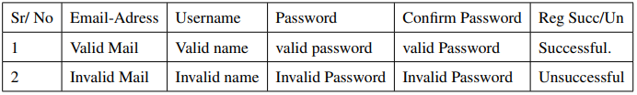
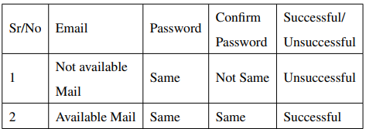
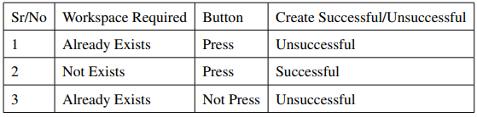
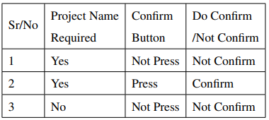
Some Major Test Case
User Registration
User Login
Workspace Creation
Project Creation
29
25-03-2022

Slide 30
Conclusion
In conclusion, this project aims to provide a user-friendly and efficient platform for project management by minimizing manual tasks. And we believe this project has a lot of scope to make a significant difference in how teams collaborate and manage their projects, and we look forward to its successful implementation and adoption by organizations.
30
25-03-2022

Slide 31
Future Works
we envision expanding the capabilities of this project management software with integrations to other tools, advanced reporting and analytics features, and a mobile app for on-the-go project management.
These enhancements would further improve collaboration and efficiency for teams while delivering more comprehensive insights into project performance.
31
25-03-2022

Slide 32
References
Agile Manifesto. Manifesto for agile software development. 2001.
Robert Cecil Martin. Agile software development: principles, patterns, and practices. Prentice
Hall PTR, 2003.
Adnane Belout and Clothilde Gauvreau. Factors influencing project success: the impact of human resource management. International journal of project management, 22(1):1–11, 2004.
John Fisher, D Koning, and AP Ludwigsen. Utilizing atlassian jira for large scale software development management. Technical report, Lawrence Livermore National Lab.(LLNL), Livermore, CA (United States), 2013.
Henrik Kniberg and Mattias Skarin. Kanban and Scrum-making the most of both. Lulu. com, 2010.
www.atlassian.com/software/jira
www.basecamp.com
www.asana.com
32
25-03-2022

Slide 33

Have any Question?
33

Slide 34
Thanks!
34
25-03-2022

